Slide 1
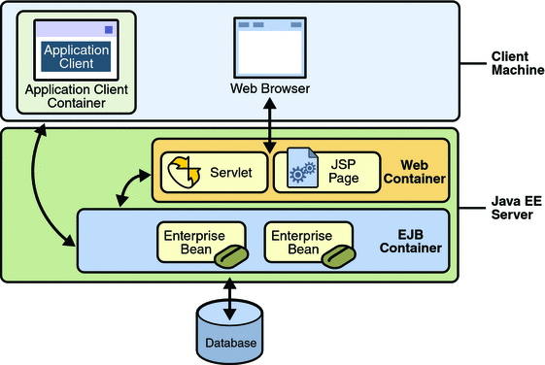
Java- EE Web Application Programming
Servlet = java program running in server
←Your cloud
←run in application server

Slide 2
General Java EE Web Application (Webapp)
Web Application (Webapp)
A web application (or webapp), unlike standalone application, runs over the Internet inside a server. Examples of webapps are google, amazon, ebay, facebook and twitter.
A webapp is typically a 3-tier (or multi-tier) client-server database application run over the Internet as illustrated in the diagram below. It comprises five components:
HTTP Server or Web Server: E.g., Apache HTTP Server, Apache Tomcat Server, Microsoft Internet Information Server (IIS), nginx, Google Web Server (GWS), and others.
HTTP Client or Web Browser: E.g., Internet Explorer (MSIE), FireFox, Chrome, Safari, and others.
Database: E.g., Open-source MySQL, Apache Derby, mSQL, SQLite, PostgreSQL, OpenOffice's Base; Commercial Oracle, IBM DB2, SAP Sybase, MS SQL Server, MS Access; and others.
Client-Side Programs: could be written in HTML Form, CSS3, JavaScript, VBScript, Flash, and others.
Server-Side Programs: could be written in Java Servlet/JSP, ASP, PHP, Perl, Python, CGI, and others.

Slide 3
What is Java EE Application?
Java EE is actually a collection of technologies and APIs for the Java platform designed to support "Enterprise" Applications which can generally be classed as large-scale, distributed, transactional and highly-available applications designed to support mission-critical business requirements.
Java EE is a collection of specifications for developing and deploying enterprise applications.
In general, enterprise applications refer to software hosted on servers that provide the applications that support the enterprise.
The specifications (defined by Sun) describe services, application programming interfaces (APIs), and protocols.
The Java EE product provider is typically an application-server, web-server, or database-system vendor who provides classes that implement the interfaces defined in the specifications. These vendors compete on implementations of the Java EE specifications.
When a company requires Java EE experience what are they really asking for is experience using the technologies that make up Java EE. Frequently, a company will only be using a subset of the Java EE technologies.

Slide 4
The 13 core technologies that make up Java EE are:
JDBC – Java Database Connection
JNDI – Java Naming Directory Interface
EJB – Enterprise Java Bean
RMI – Remote Method Invocation
JSP
Java servlets
XML
JMS – Java Message Service API
Java IDL -
JTS – Java Transaction Service
JTA
JavaMail
JAF

Slide 5
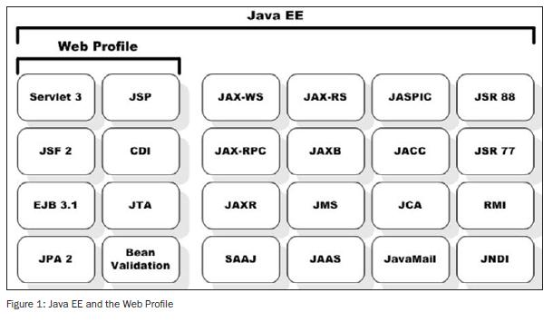
Java Enterprise Edition (Java EE) 8 Java EE APIs

Slide 6
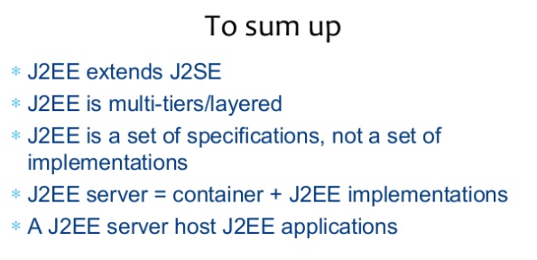

Slide 7
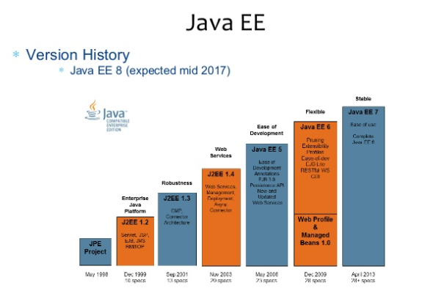

Slide 8
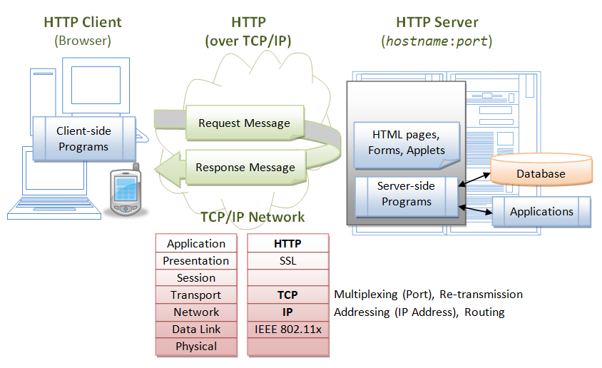

Slide 9
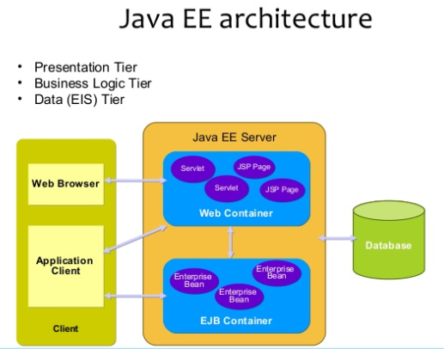

Slide 10
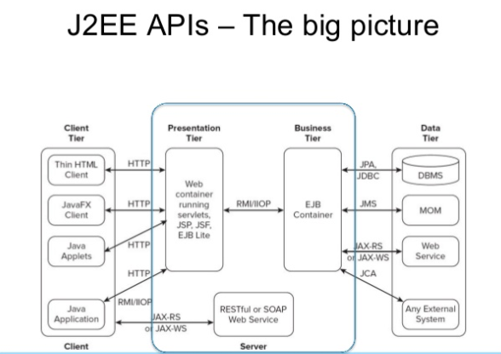

Slide 11
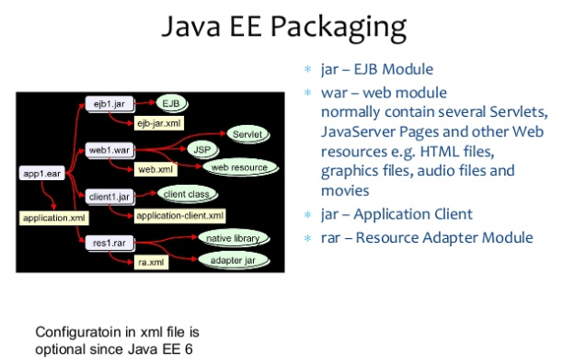

Slide 12
Hypertext Transfer Protocol (HTTP)
HTTP is an application layer protocol runs over TCP/IP. The IP provides support for routing and addressing (via an unique IP address for machines on the Internet); while TCP supports multiplexing via 64K ports from port number 0 to 65535. The default port number assigned to HTTP is TCP port 80.
HTTP is an asynchronous request-response application-layer protocol. A client sends a request message to the server. The server then returns a response message to the client. In other words, HTTP is a pull protocol, a client pulls a page from the server (instead of server pushes pages to the clients).
The syntax of the message is defined in the HTTP specification.

Slide 13
Java EE Web Apps typical workflow
A user, via a web browser (HTTP client), issues a URL request to an HTTP server to start a webapp.
The HTTP server returns an HTML form (client-side program), which is loaded into the client's browser.
The user fills up the query criteria inside the form and submits the form.
The client-side program sends the query parameters to a server-side program.
The server-side program receives the query parameters, queries the database based on these parameters, and returns the query result to the client-side program.
The client-side program displays the query result on the browser.
The process repeats for the next request.

Slide 14
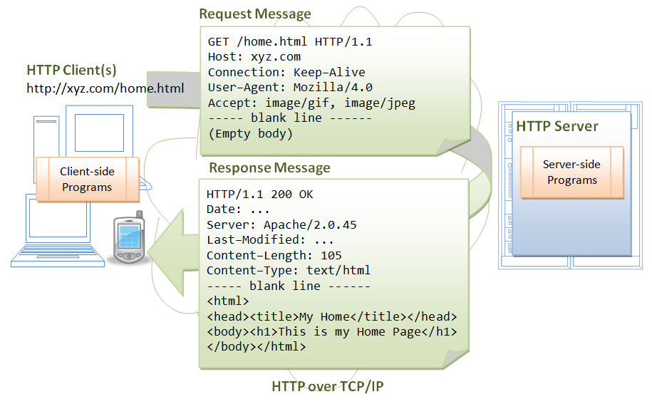

Slide 15

Apache Tomcat Server

Slide 16
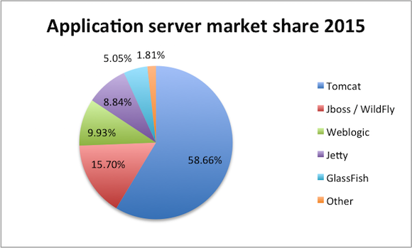

Slide 17
Apache Tomcat HTTP Server
Apache Tomcat is a Java-capable HTTP server, which could execute special Java programs known as "Java Servlet" and "Java Server Pages (JSP)".
Tomcat is an open-source project, under the "Apache Software Foundation" (which also provides the most use, open-source, industrial-strength Apache HTTP Server).
Tomcat was originally written by James Duncan Davison (then working in Sun), in 1998, based on an earlier Sun's server called Java Web Server (JWS). Sun subsequently made Tomcat open-source and gave it to Apache.
Tomcat is an HTTP application runs over TCP/IP. In other words, the Tomcat server runs on a specific TCP port from a specific IP address.
The default TCP port number for HTTP protocol is 80, which is used for the production HTTP server.
For test HTTP server, you can choose any unused port number between 1024 and 65535.

Slide 18
Apache Tomcat releases
The various Tomcat releases are:
Tomcat 3.x (1999): RI for Servlet 2.2 and JSP 1.1.
Tomcat 4.x (2001): RI for Servlet 2.3 and JSP 1.2.
Tomcat 5.x (2002): RI for Servlet 2.4 and JSP 2.0.
Tomcat 6.x (2006): RI for Servlet 2.5 and JSP 2.1.
Tomcat 7.x (2010): RI for Servlet 3.0, JSP 2.2 and EL 2.2.
Tomcat 8.x (2013): RI for Servlet 3.1, JSP 2.3, EL 3.0 and WebSocket 1.0.
Tomcat 9.x (2018): RI for Servlet 4.0, JSP 2.3, EL 3.0, WebSocket 1.0, JASPIC 1.1.

Slide 19
How to Install Tomcat 8
STEP 0: Create a Directory to Keep all your Works
Create a directory called "c:\myWebProject" (for Windows).
STEP 1: Download and Install Tomcat, For Windows
Goto http://tomcat.apache.org ⇒
Under "Tomcat 9.0.{xx} Released" (where {xx} is the latest upgrade number) ⇒
Click "Download" ⇒
Under "9.0.{xx}" ⇒
Binary Distributions ⇒
Core ⇒
"ZIP" package (e.g., "apache-tomcat-9.0.{xx}.zip", about 9.8 MB).
UNZIP the downloaded file into your project directory "c:\myWebProject".
Tomcat will be unzipped into directory "c:\myWebProject\apache-tomcat-9.0.{xx}".
For EASE OF USE, we shall shorten and rename this directory to "c:\myWebProject\tomcat".
Take note of Your Tomcat Installed Directory. Hereafter, I shall refer to the Tomcat installed directory as <TOMCAT_HOME>.

Slide 20
Tomcat's Directories
Tomcat installed directory. It contains the these sub-directories:
bin: contains the binaries; and startup script (startup.bat for Windows and startup.sh for Unix and Mac OS), shutdown script (shutdown.bat for Windows and shutdown.sh for Unix and Mac OS), and other binaries and scripts.
conf: contains the system-wide configuration files, such as server.xml, web.xml, context.xml, and tomcat-users.xml.
webapps: contains the webapps to be deployed. You can also place the WAR (Webapp Archive) file for deployment here.
lib: contains the Tomcat's system-wide JAR files, accessible by all webapps. You could also place external JAR file (such as MySQL JDBC Driver) here.
logs: contains Tomcat's log files. You may need to check for error messages here.
work: Tomcat's working directory used by JSP, for JSP-to-Servlet conversion.

Slide 21
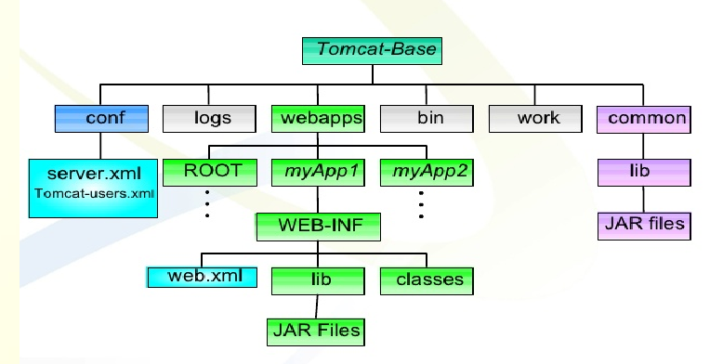
Tomcat's Directories

Slide 22
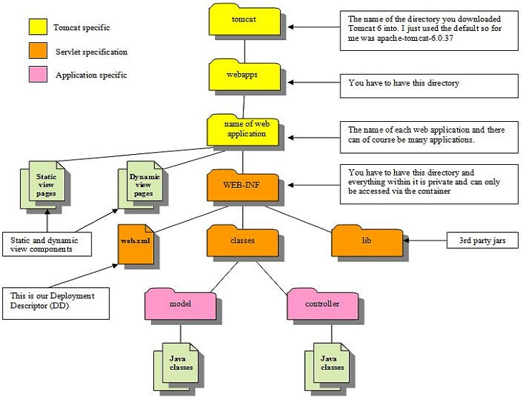

Slide 23
STEP 2: Create an Environment Variable JAVA_HOME, (For Windows)
You need to create an environment variable (system variable available to all applications) called "JAVA_HOME", and set it to your JDK installed directory.
First, find your JDK installed directory. The default is "c:\Program Files\Java\jdk-8.0.{xx}", where {xx} is the upgrade number. Take note of your JDK installed directory.
To set the environment variable JAVA_HOME in Windows 10/8/7: Launch "Control Panel" ⇒
System and Security (Optional) ⇒
System ⇒ Advanced system settings ⇒ Switch to "Advanced" tab ⇒
Environment Variables ⇒
System Variables (the bottom panel) ⇒
"New" ⇒
In "Variable Name", enter "JAVA_HOME" ⇒
In "Variable Value", enter your JDK installed directory you noted in Step 1.
To verify, RE-START a CMD (restart needed to refresh the environment) and issue:
SET JAVA_HOME
JAVA_HOME=c:\Program Files\Java\jdk-8.0.{xx} <== Verify that this is YOUR JDK installed directory

Slide 24
STEP 3: Configure Tomcat Server
The Tomcat configuration files are located in the "conf" sub-directory of your Tomcat installed directory, e.g. "c:\myWebProject\tomcat\conf" (for Windows). There are 4 configuration XML files:
server.xml
web.xml
context.xml
tomcat-users.xml
Make a BACKUP of the configuration files before you proceed!!!

Slide 25
Step 3(a) "conf\server.xml" - Set the TCP Port Number (DON’T DO THIS)
Use a programming text editor (e.g., NotePad++, TextPad, Sublime, Atom for Windows; to open the configuration file "server.xml", under the "conf" sub-directory of Tomcat installed directory.
The default TCP port number configured in Tomcat is 8080, you may choose any number between 1024 and 65535, which is not used by an existing application. We shall choose 9999. (For production server, you should use port 80, which is pre-assigned to HTTP server as the default port number.)
Locate the following lines (around Line 69) that define the HTTP connector, and change port="8080" to port="9999".
<!-- A "Connector" represents an endpoint by which requests are received and responses are returned. Documentation at : Java HTTP Connector: /docs/config/http.html, Java AJP Connector: /docs/config/ajp.html, APR (HTTP/AJP) Connector: /docs/apr.html, Define a non-SSL HTTP/1.1 Connector on port 8080 -->
<Connector port="9999" protocol="HTTP/1.1“ connectionTimeout="20000“
redirectPort="8443" />

Slide 26
Step 3(b) "conf\web.xml" - Enabling Directory Listing
Use a text editor to open the configuration file "web.xml", under the "conf" sub-directory of Tomcat installed directory.
We shall enable directory listing by changing "listings" from "false" to "true" for the "default" servlet. This is handy for test system, but not for production system for security reasons.
Locate the following lines (around Line 108) that define the "default" servlet; and change the "listings" from "false" to "true".
<servlet>
<servlet-name>default</servlet-name>
<servlet-class>org.apache.catalina.servlets.DefaultServlet</servlet-class>
<init-param>
<param-name>debug</param-name>
<param-value>0</param-value>
</init-param>
<init-param>
<param-name>listings</param-name>
<param-value>true</param-value>
</init-param>
<load-on-startup>1</load-on-startup>
</servlet>

Slide 27
Step 3(c) "conf\context.xml" - Enabling Automatic Reload
We shall add the attribute reloadable="true" to the <Context> element to enable automatic reload after code changes. This is handy for test system but not for production, due to the overhead of detecting changes.
Locate the <Context> start element (around Line 19), and change it to <Context reloadable="true">.
<Context reloadable="true">
......
......
</Context>

Slide 28
Step 3(d) (Optional) "conf\tomcat-users.xml“
Enable the Tomcat's manager by adding the highlighted lines, inside the <tomcat-users> elements:
<tomcat-users>
<role rolename="manager-gui"/>
<user username="mymanager" password=“gopi" roles="manager-gui"/>
</tomcat-users>
This enables the manager GUI app for managing Tomcat server.

Slide 29
STEP 4: Start Tomcat Server
The Tomcat's executable programs and scripts are kept in the "bin" sub-directory of the Tomcat installed directory.
Step 4(a) Start Server, For Windows
Assume that Tomcat is installed in "c:\myWebProject\tomcat". Launch a CMD shell and issue:
c: // Change drive
cd \myWebProject\tomcat\bin // Change directory to your Tomcat's binary
directory
startup // Start tomcat server
A new Tomcat console window appears. Study the messages on the console. Look out for the Tomcat's port number (double check that Tomcat is running on port 9999). Future error messages will be send to this console. System.out.println() issued by your Java servlets will also be sent to this console.
......
xxxxx INFO [main] org.apache.coyote.AbstractProtocol.start Starting ProtocolHandler ["http-nio-9999"]
xxxxx INFO [main] org.apache.coyote.AbstractProtocol.start Starting ProtocolHandler ["ajp-nio-8009"]
xxxxx INFO [main] org.apache.catalina.startup.Catalina.start Server startup in 1325 ms

Slide 30
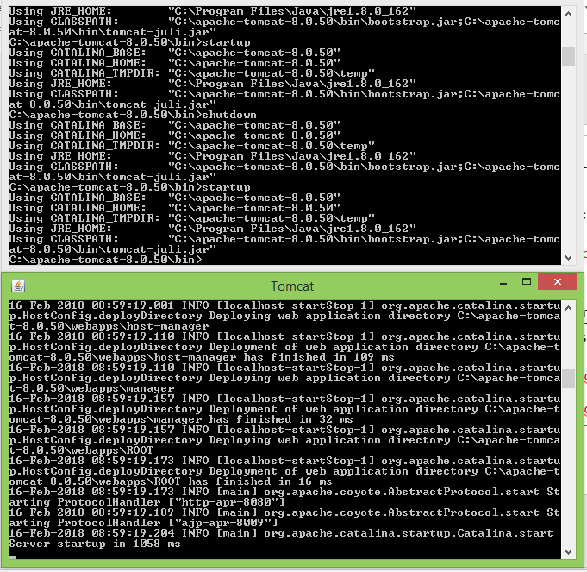

Slide 31
Step 4(b) Start a Client to Access the Server
Start a browser (Firefox, Chrome) as an HTTP client. Issue URL "http://localhost:8080" to access the Tomcat server's welcome page. The hostname "localhost" (with IP address of 127.0.0.1) is meant for local loop-back testing inside the same machine.
For users on the other machines over the net, they have to use the server's IP address or DNS domain name or hostname in the format of "http://serverHostnameOrIPAddress:8080".
Try issuing URL http://localhost:8080/examples to view the servlet and JSP examples. Try running some of the servlet examples.
(Optional) Try issuing URL http://localhost:8080/manager/html to run the Tomcat Web Manager.
Enter the username and password configured earlier in tomcat-users.xml.

Slide 32
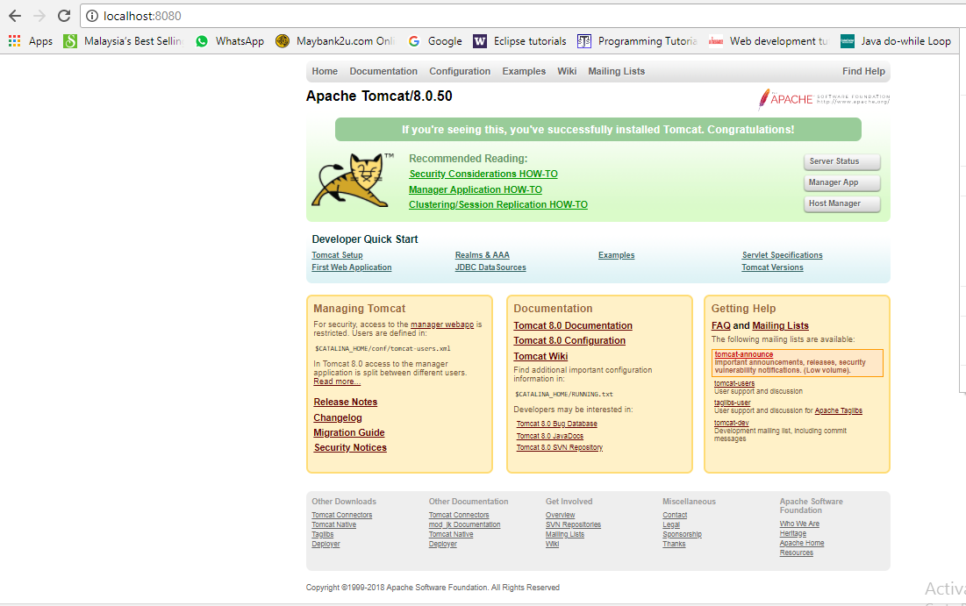

Slide 33
Step 4(c) Shutdown Server, For Windows
You can shutdown the tomcat server by either:
Press Ctrl-C on the Tomcat console; OR
Run "<TOMCAT_HOME>\bin\shutdown.bat" script.
Open a new "cmd" and issue:
c: // Change the current drive
cd \myWebProject\tomcat\bin // Change directory to your Tomcat's binary
// directory
shutdown // Shutdown the server
WARNING: You MUST properly shutdown the Tomcat. DO NOT kill the cat by pushing the window's "CLOSE" button.

Slide 34
STEP 5: Develop and Deploy a WebApp
Step 5(a) Create the Directory Structure for your WebApp
Let's call our first webapp "hello". Goto Tomcat's "webapps" sub-directory and create the following directory structure for your webapp "hello" :
Under Tomcat's "webapps", create your webapp's root directory "hello" (i.e., "<TOMCAT_HOME>\webapps\hello").
Under "hello", create a sub-directory "WEB-INF" (case sensitive, a "dash" not an underscore) (i.e., "<TOMCAT_HOME>\webapps\hello\WEB-INF").
Under "WEB-INF", create a sub-sub-directory "classes" (case sensitive, plural) (i.e., "<TOMCAT_HOME>\webapps\hello\WEB-INF\classes").
You need to keep your web resources (e.g., HTMLs, CSSs, images, scripts, servlets, JSPs) in the proper directories:
"hello": The is called the context root (or document base directory) of your webapp.
You should keep all your HTML files and resources visible to the web users (e.g., HTMLs, CSSs, images, scripts, JSPs) under this context root.
"hello/WEB-INF": This directory, although under the context root, is not visible to the web users. This is where you keep your application's web descriptor file "web.xml".
"hello/WEB-INF/classes": This is where you keep all the Java classes such as servlet class-files.

Slide 35
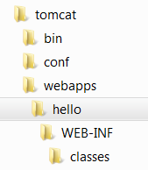
Directory Structure for your WebApp, hello

Slide 36
You should RE-START your Tomcat server to pick up the hello webapp. Check the Tomcat's console to confirm that "hello" application has been properly deployed:
......
xxxxx INFO [main] org.apache.catalina.startup.HostConfig.deployDirectory
Deploying web application directory [xxx\webapps\hello]
xxxxx INFO [main] org.apache.catalina.startup.HostConfig.deployDirectory
Deployment of web application directory [xxx\webapps\hello] has finished in [38] ms
......
You can issue the following URL to access the web application "hello":
http://localhost:9999/hello
You should see the directory listing of the directory "<TOMCAT_HOME>\webapps\hello", which shall be empty at this point of time. (Take note that we have earlier enabled directory listing in "web.xml". Otherwise, you will get an error "404 Not Found").

Slide 37
Step 5(b) Write a Welcome Page
Create the following HTML page and save as "HelloHome.html" in your application's root directory "hello".
<html>
<head><title>My Home Page</title></head>
<body>
<h1>My Name is so and so. This is my HOME.</h1>
</body>
</html>
You can browse this page by issuing this URL:
http://localhost:9999/hello/HelloHome.html

Slide 38
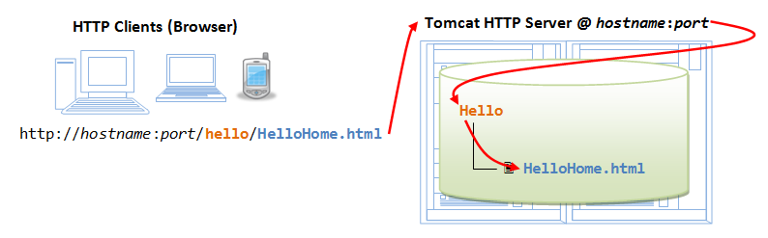

Slide 39
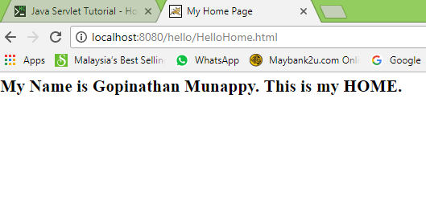

Slide 40
Alternatively, you can issue an URL to your web application root "hello":
http://localhost:8080/hello
The server will return the directory listing of your base directory. You can then click on "HelloHome.html".
Rename "HelloHome.html" to "index.html", and issue a directory request again:
http://localhost:8080/hello
Now, the server will redirect the directory request to "index.html", if the root directory contains an "index.html", instead of serving the directory listing.
You can check out the home page of your peers by issuing:
http://YourPeerHostnameOrIPAddress:8080/hello
http://YourPeerHostnameOrIPAddress:8080/hello/HelloHome.html
http://YourPeerHostnameOrIPAddress:8080/hello/index.html
with a valid "YourPeerHostnameOrIPAddress", provided that your peer has started his tomcat server and his firewall does not block your access. You can use command such as "ipconfig" (Windows), "ifconfig" (Mac OS and Unix) to find your IP address.

Slide 41
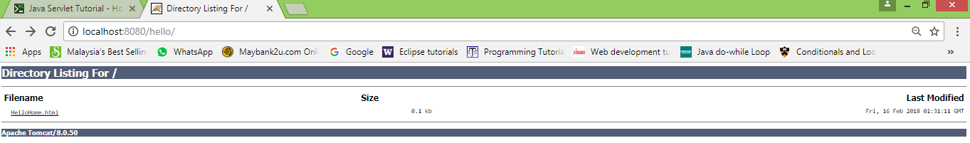

Slide 42
Conclusions
A small web page is create in the form of HTML file and deployed in HTTP server, Apache Tomcat.
Accessed this resource i.e. HTML file from a browser client.

